Slide 1

Unlocking Strategic Advantages: A Business Case for Implementing Business Intelligence for Informed Decision-Making and Competitive Edge.
BY
HALEEMA KHATOON
Notes:
Slide 1: Unlocking Strategic Advantages
"Good morning, everyone! Today, we're diving into the world of Business Intelligence and how it can be a game-changer for our organization. The presentation aims to explore the implementation of BI tools, specifically Power BI and Tableau, for more informed decision-making and gaining a competitive edge. Let's get started!"

Slide 2
BI Implementation Business Case
Rationale for Transition: Proposing the Adoption of BI Tools, Including Power BI and Tableau, to Enhance Data Analysis and Visualization Capabilities.
Notes:
Slide 2: Rationale for Transition
"Why should we consider transitioning to Business Intelligence tools like Power BI and Tableau? The answer lies in enhancing our data analysis and visualization capabilities. These tools offer a new level of insight and efficiency in handling our data. It's not just a transition; it's a strategic move for the betterment of our decision-making processes."

Slide 3
Excel VS BI Tools
Microsoft Excel | BI Tools
Lacks interactive and collaborative features. Prone to human errors, risking customer loss. Visuals are less appealing and dynamic. | Offers collaboration and sharing features. Provides mobile apps for connectivity on the go. Maintains high-security standards.
Processes data at a slower pace. Operations are time-consuming. Lower security, susceptible to fraud and corruption. | Creates dynamic and visually appealing interactive dashboards. Processes large amounts of data swiftly. Facilitates quicker trend analysis. Cost Consideration: BI tools may involve higher expenses.
Notes:
Slide 3: Excel VS BI Tools
"Now, let's compare the trusted Microsoft Excel with the advanced BI Tools. Excel, while a familiar companion, lacks interactive features, is prone to errors, and can be time-consuming. On the other hand, BI Tools like Power BI and Tableau create dynamic, visually appealing dashboards, process data swiftly, and facilitate quicker trend analysis. The cost may be a consideration, but the benefits far outweigh, especially when considering the enhanced security and collaborative features."

Slide 4

Analysis Of Sales Data
Notes:
Slide 4: Analysis Of Sales Data
"Now, let's delve into the real-world application of BI tools as we analyze sales data.

Slide 5

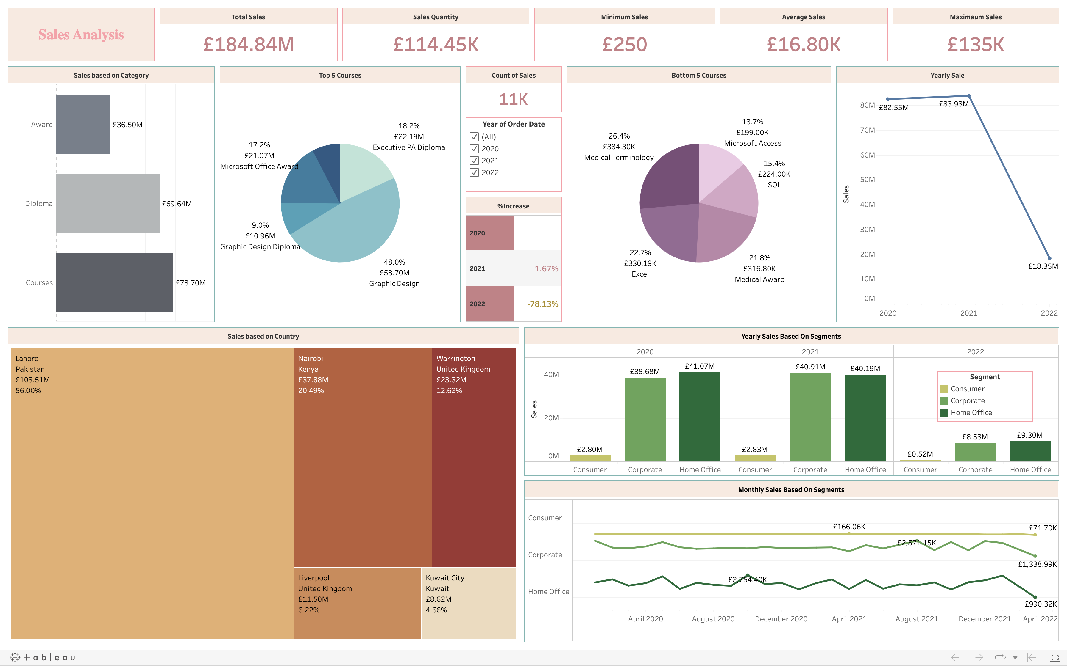
Tableau Sales Dashboard

Slide 6

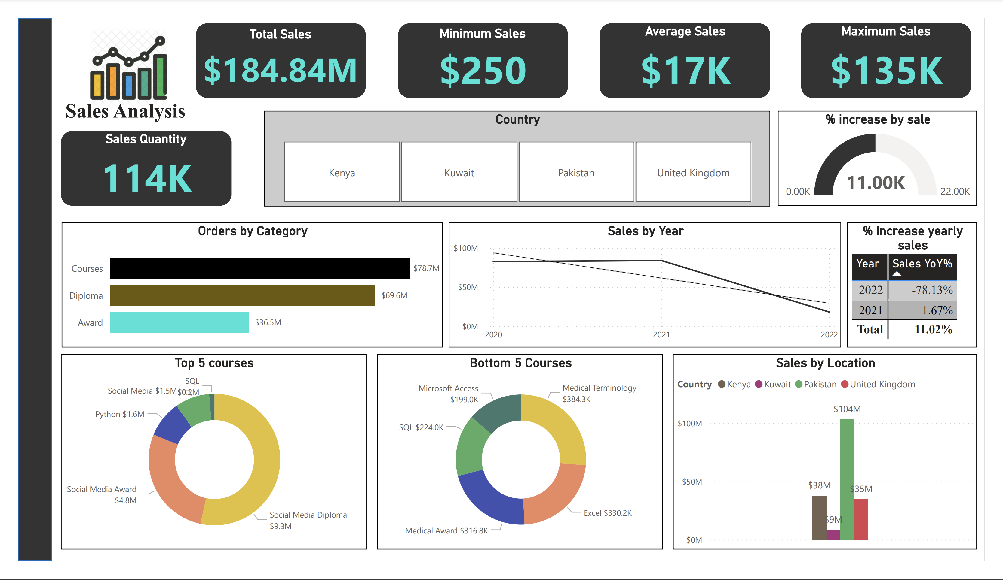
Power BI Sales Dashboard
Notes:
Slide 4: Analysis Of Sales Data
The objective here is crystal clear – we aim for strategic decision-making. Armed with the powerful capabilities of both Power BI and Tableau, our journey involves not just data analysis but a strategic advantage. Picture swift and accurate analysis, dynamic visualizations that unveil trends, and, most importantly, the ability to make informed decisions that shape our strategy.

Slide 7
Analysis of HR data
Notes:
Slide 5: Analysis of HR Data
"As we continue our exploration, let's shift our focus to the intricate world of HR data.

Slide 8
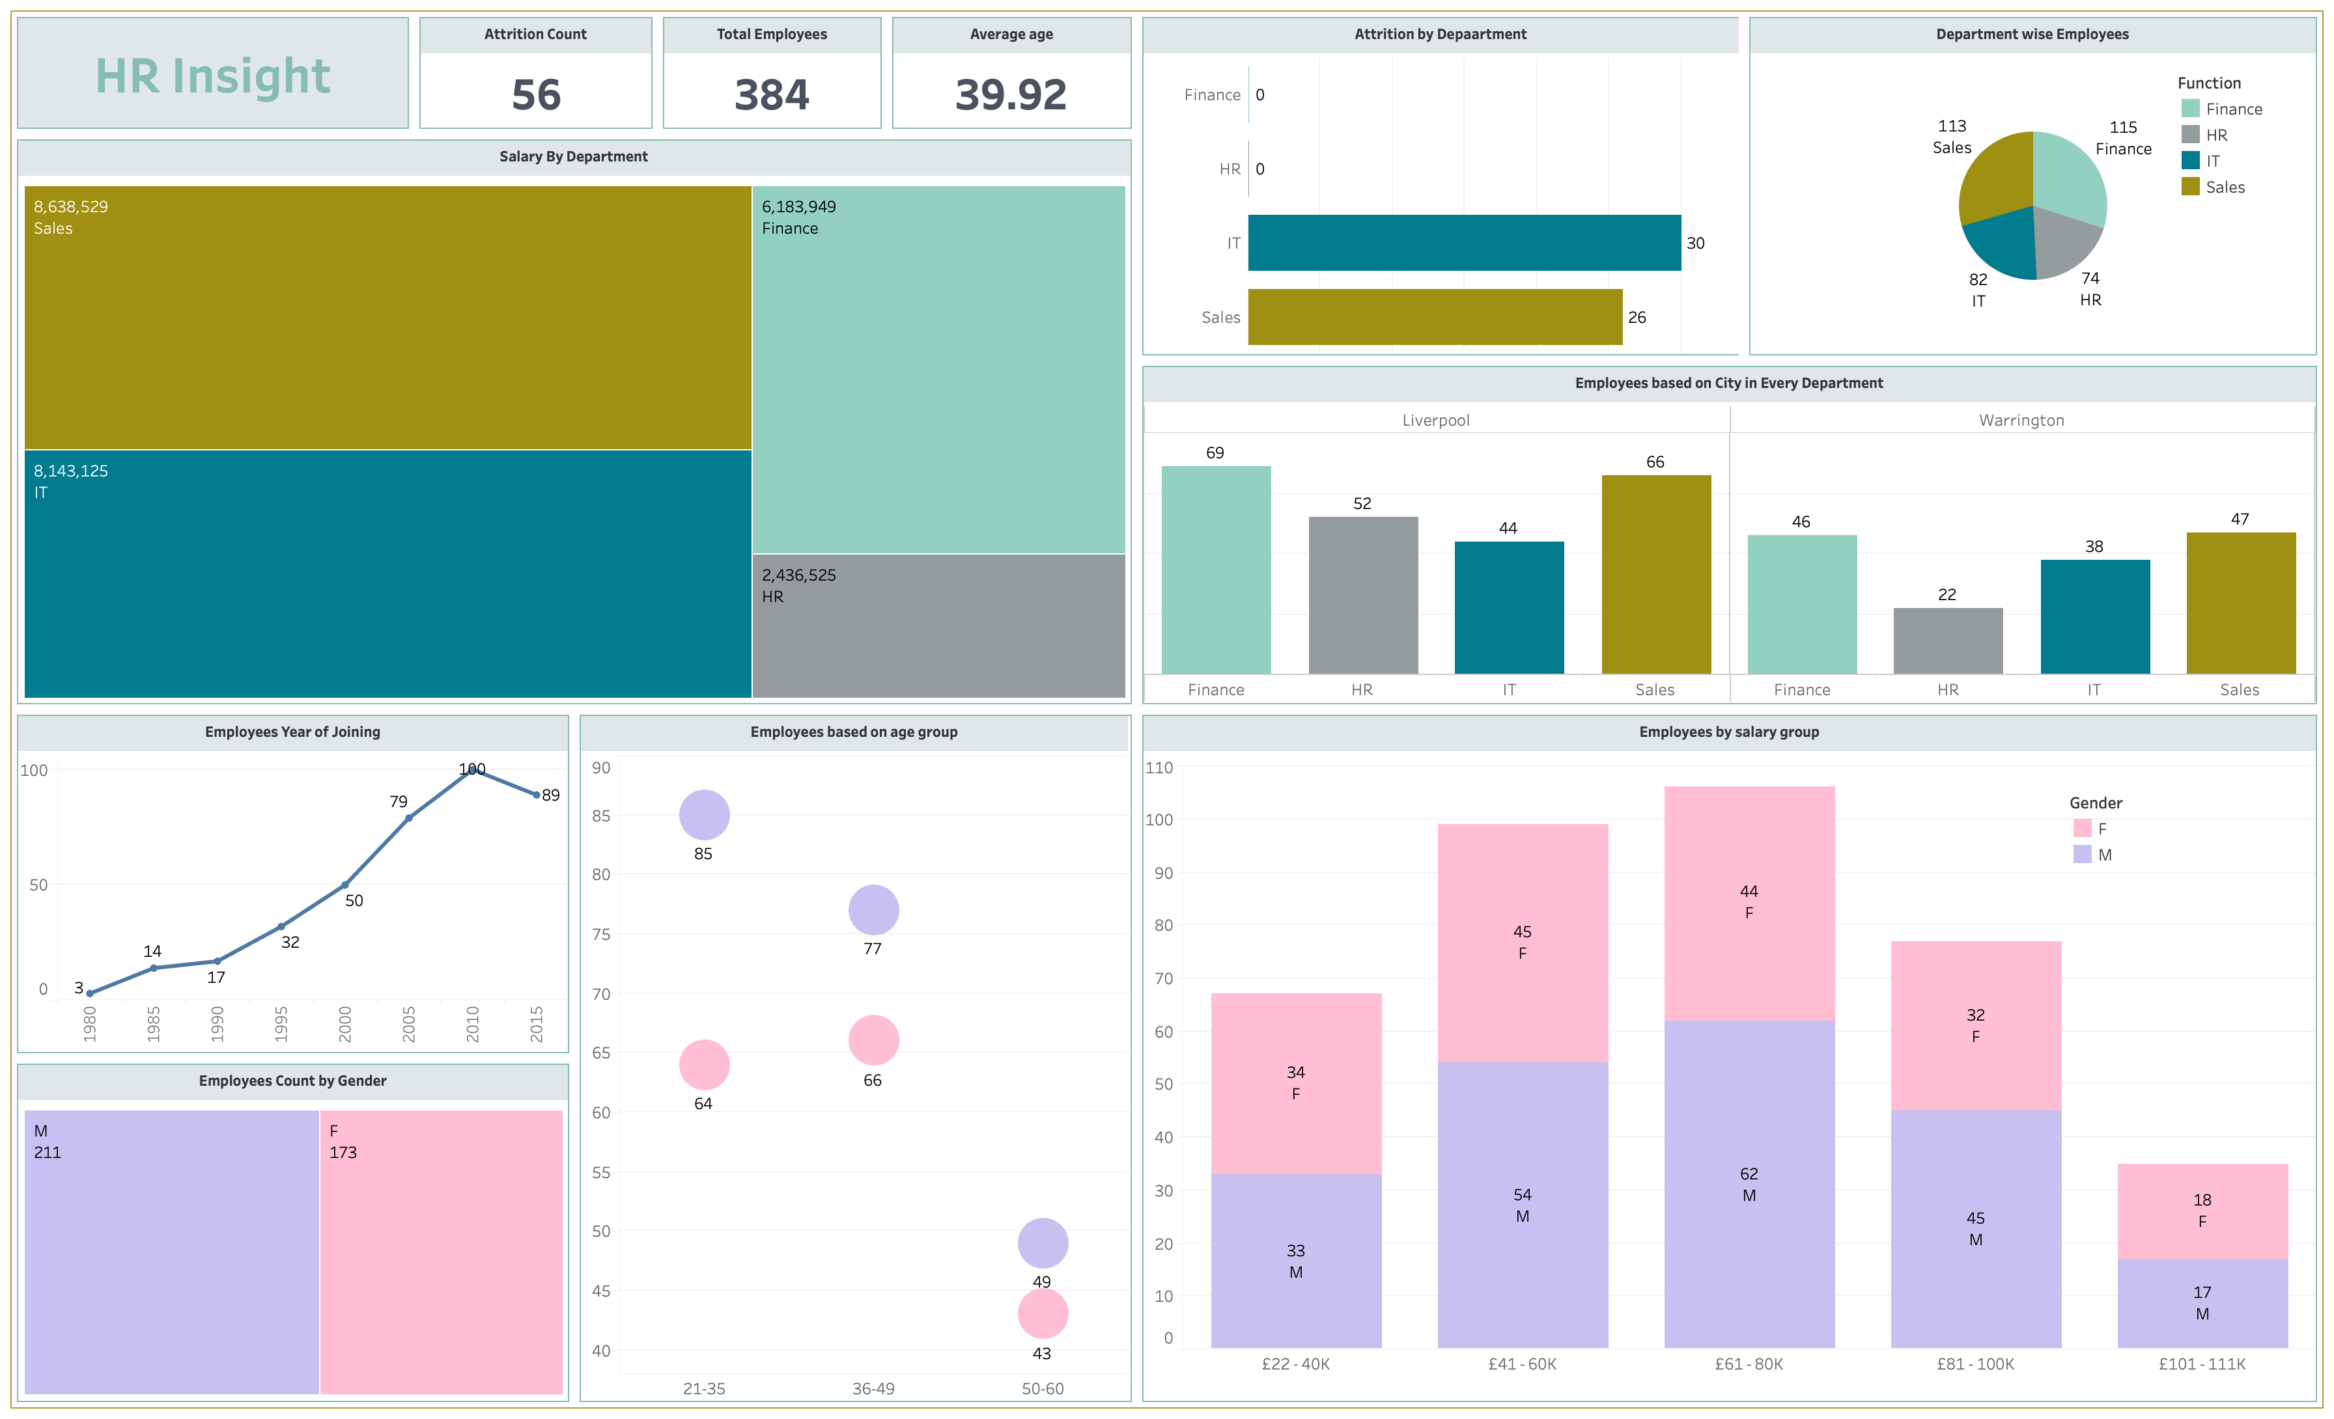
Tableau HR Dashboard

Slide 9
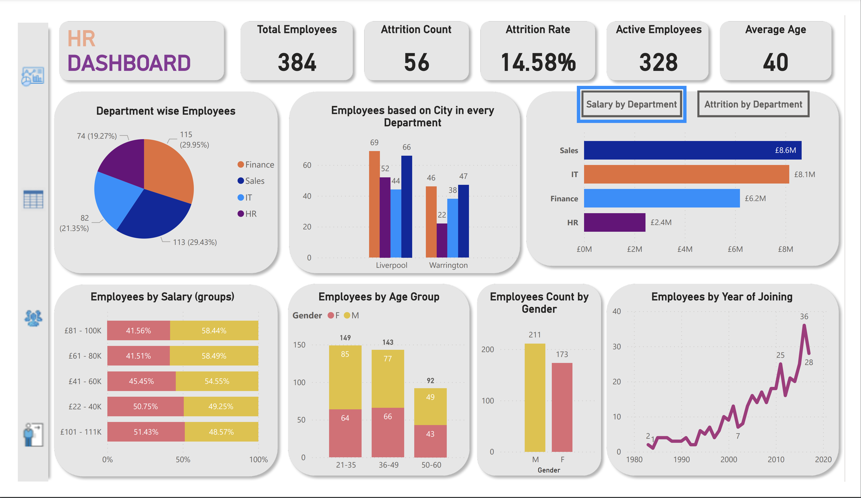
Power BI HR Dashboard

Slide 10
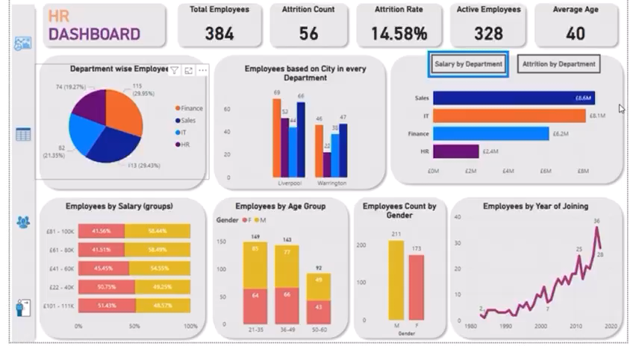
Power BI HR Report
Notes:
Here, BI tools, with their dynamic and comprehensive insights, transform HR analysis from a mere task into a powerful tool for strategic HR management. The opportunities are vast – from effective workforce decisions to substantial improvements in organizational performance. Imagine having the ability to gain insights into employee engagement, productivity, and overall organizational health. BI tools empower us to elevate HR data from numbers on a spreadsheet to actionable insights that contribute to the overall success of our organization."

Slide 11
HR & SALES Data
Notes:
HR & Sales Data
"Now, let's connect the dots between HR and Sales data, creating a holistic understanding that becomes a cornerstone for strategic decision-making.

Slide 12

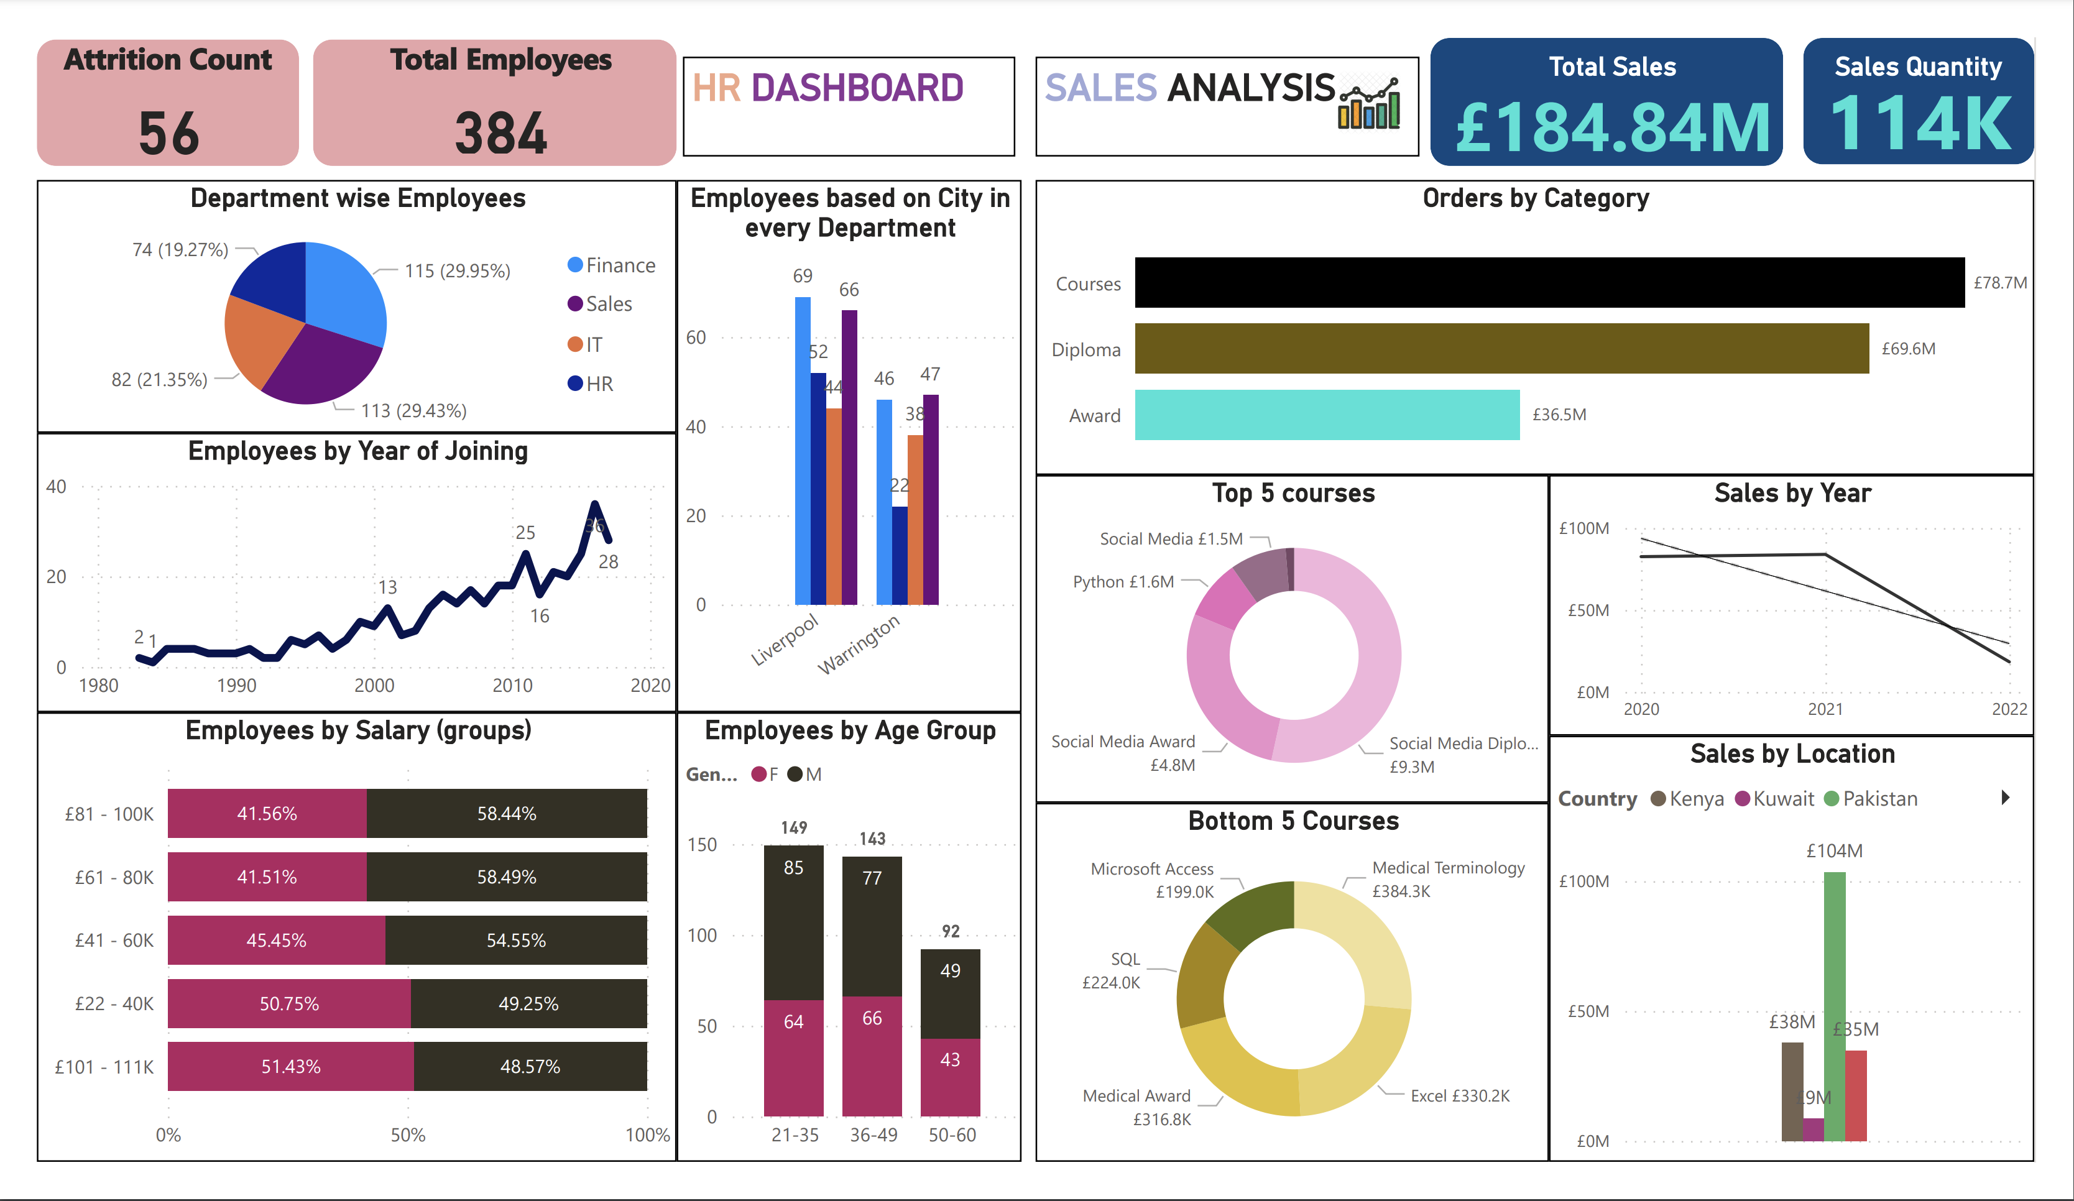
Infographic on Sales & HR

Slide 13
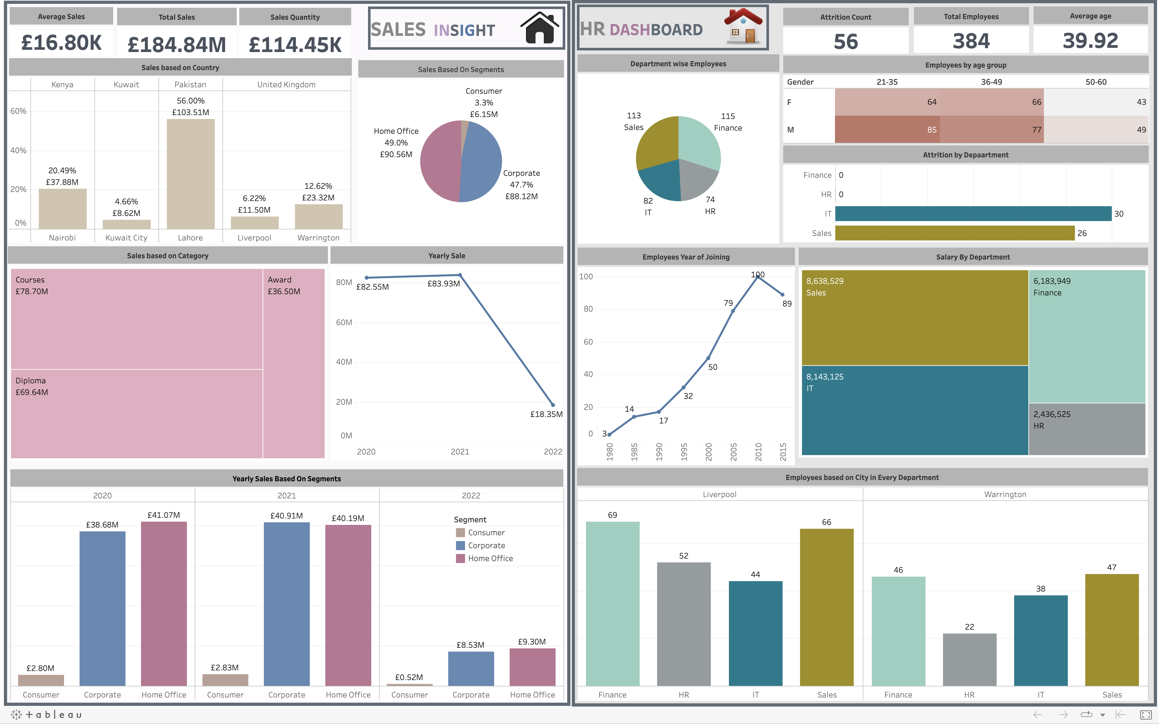
Infographic on Sales & HR

Slide 14
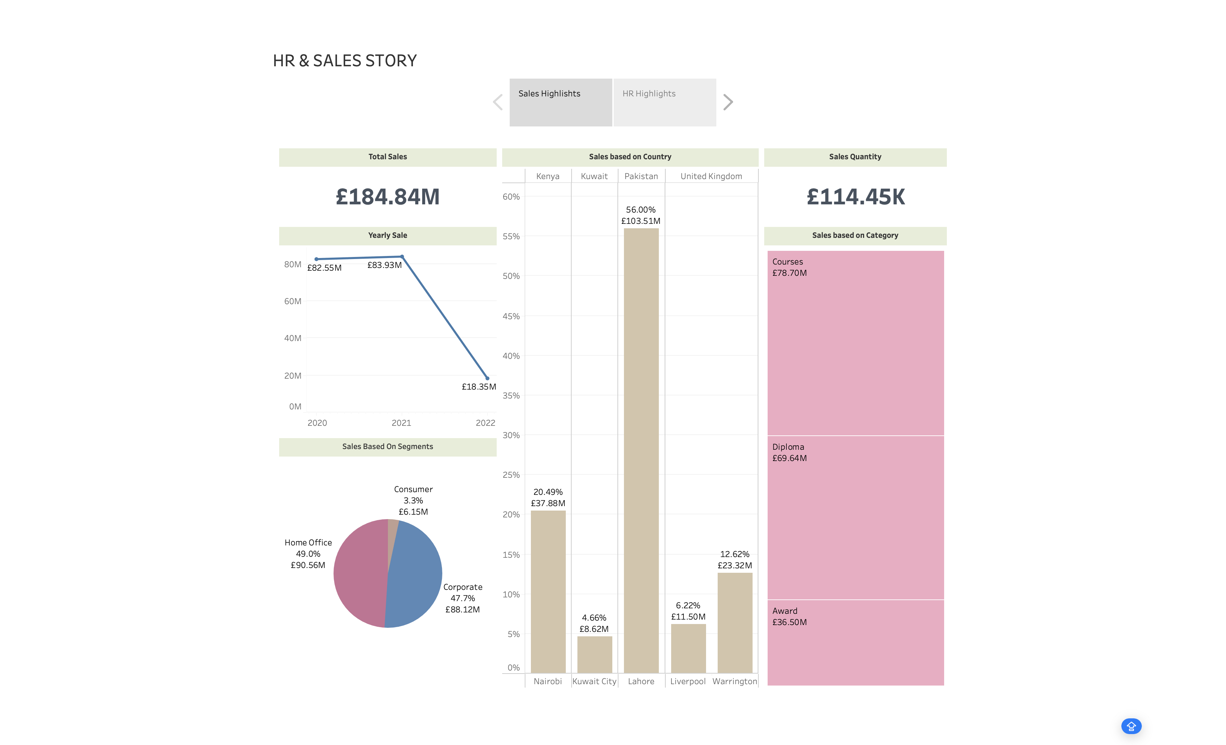

SALES Highlights
The Courses category stands out with the highest sales at £78.70M, surpassing all other categories.
Category : Courses
Sales : £78.70M
Yearly trends show a slight increase from £82.55M in 2020 to £83.93M in 2021, but a notable drop to £18.35M in 2022. This significant decline demands a closer look at contributing factors and underscores the need for strategic adjustments moving forward.
Year : 2021
Sale: £83.93M
Year : 2022
Sales : £18.35M
Pakistan, specifically Lahore, leads in sales with an impressive £103.51M.
City : Lahore
Sales : £103.51M
The Home Office segment takes the lead, commanding 49% of total sales with a substantial £90.56M.
Segments : Home Office
Sales : £ 90.56M

Slide 15
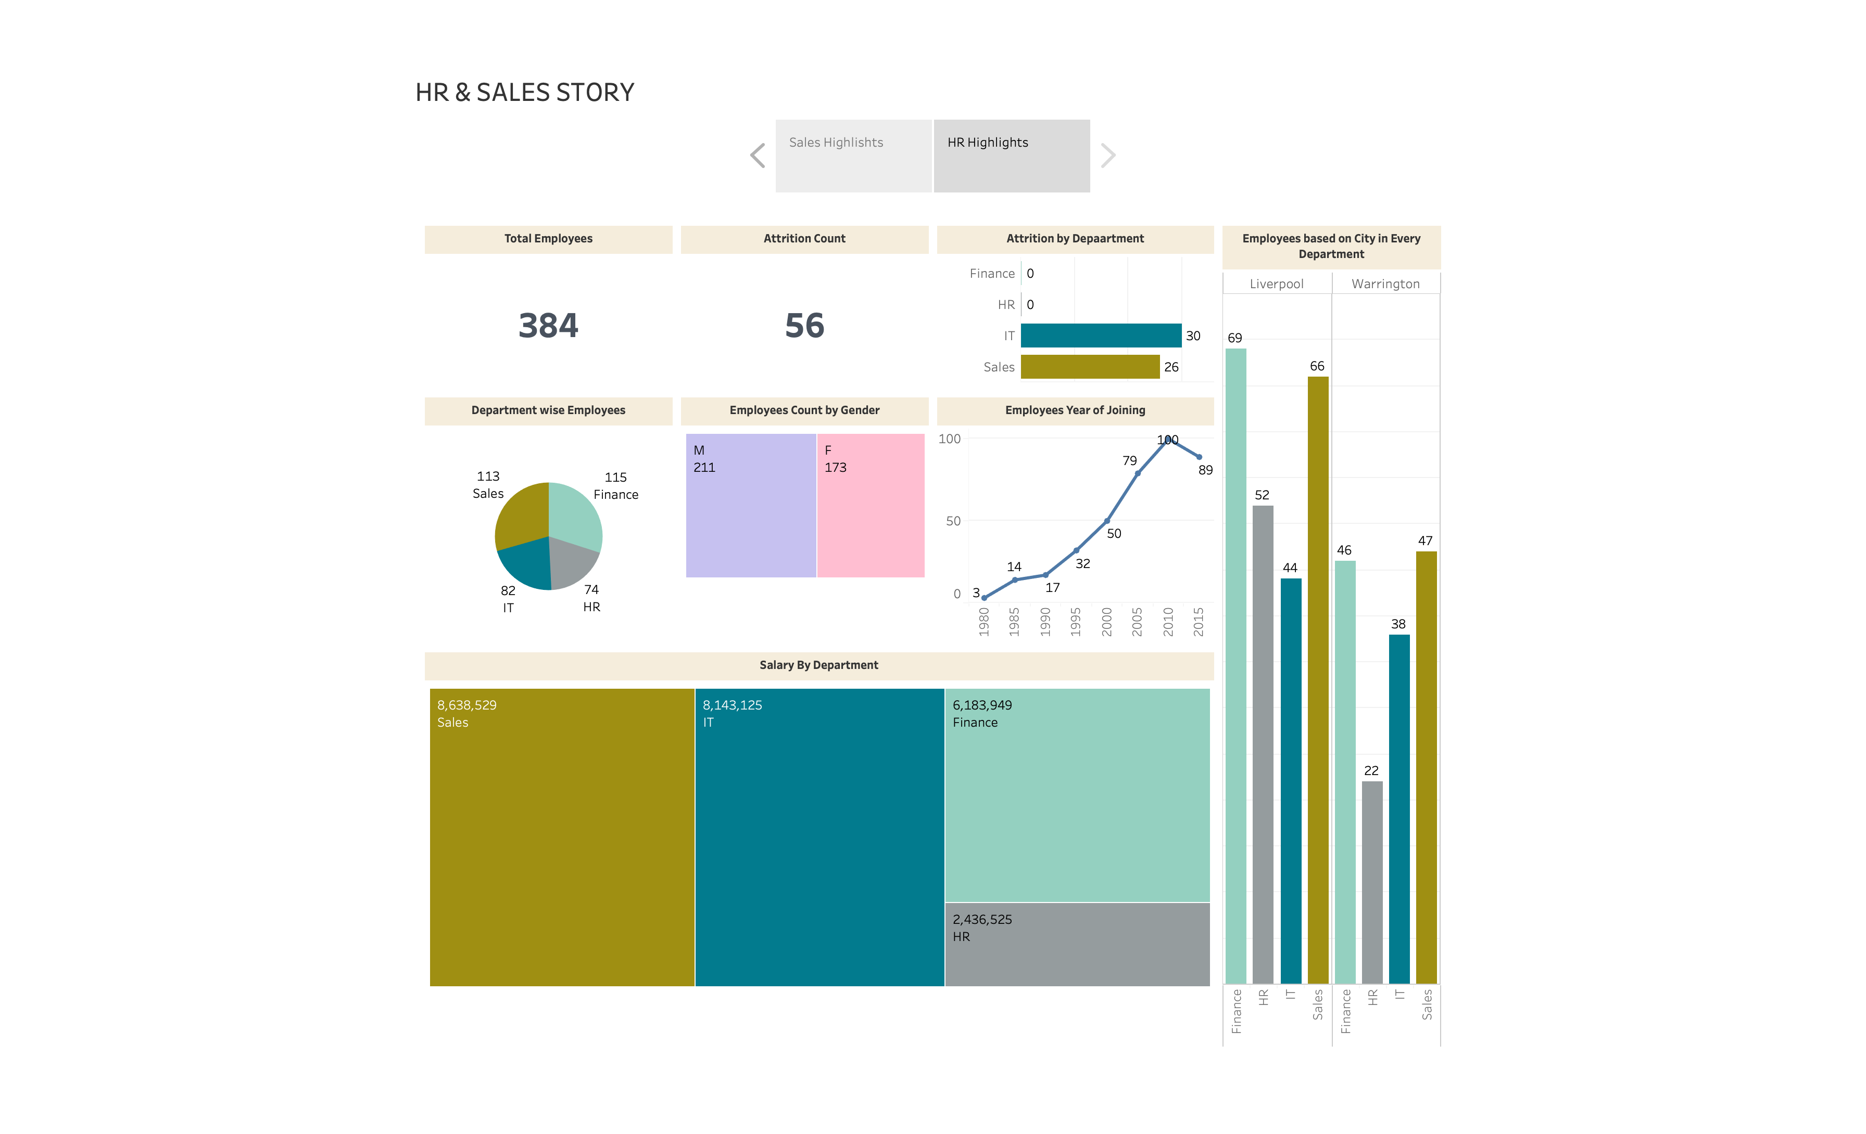
HR Highlights
Liverpool surpasses Warrington in total employees, particularly excelling in the Finance and Sales departments.
The Finance Department boasts a robust workforce, with 115 employees contributing to its operational strength
.
Department : Finance
Employees: 115
In the pivotal year of 2010, a noteworthy 100 employees joined, marking a substantial growth period for the organization.
Emp Count : 100
Year : 2010
The Sales Department secures the top spot with the highest total salary, amounting to £8.64M.
Salary: 8.64M
Department: Sales
(£8.64M)
(£8.14M)
(£6.18M)
(£2.44M)
Notes:
This is where the true power of BI tools shines through. We've not just analyzed individual datasets; we've orchestrated a symphony of insights by integrating HR and Sales data seamlessly. Visualize the impact – informed decisions that consider both the human capital and sales dynamics. Our BI tools play a crucial role in this integration, allowing us to create dashboards that provide a unified view across departments. It's not just about the data; it's about creating a narrative that guides our decisions and propels us toward success."

Slide 16

Power BI vs Tableau
Notes:
"Now, the moment of comparison – Power BI vs Tableau. Understanding the differences is essential for making an informed choice. While Power BI is user-friendly and cost-effective, Tableau excels with larger datasets and visually appealing dashboards, making it a favorite for medium and large enterprises. The choice ultimately depends on our specific needs and budget considerations."

Slide 17
Introduction
Business Intelligence (BI) is vital for organizations today.
Power BI and Tableau are leading BI tools.
Data analytics market expected to reach USD $329.8 billion by 2030.
Notes:
1.Business intelligence is the backbone of decision-making in today's organizations.
2.In our journey today, we'll be focusing on two powerful tools that have revolutionized the BI landscape: Power BI and Tableau.
3.The global data analytics market is projected to reach an astounding USD $329.8 billion by 2030, underscoring the critical role these tools play in extracting insights from vast datasets."

Slide 18
Tableau Overview
Interactive data visualization tool.
Acquired by Salesforce in 2019.
Key Features:
Vector maps
Nested sorting
Data collaboration
Companies using Tableau: UN World Food Programme, Wipro, LinkedIn.
Notes:
Tableau Overview
Let's start our exploration with Tableau.
Founded in 2003 and acquired by Salesforce in 2019, Tableau is an interactive data visualization tool that empowers organizations to simplify the process of data analysis.
Its robust features include vector maps for cleaner geospatial data exploration,
nested sorting for enhanced data organization,
and data collaboration for effective team communication.
Notable organizations such as the UN World Food Programme and Wipro have embraced Tableau to derive meaningful insights from their data."

Slide 19
Power BI Overview
BI and data visualization tool by Microsoft.
Publicly available since 2015.
Key Features:
Filtration
DAX
Real-time dashboards
Companies using Power BI: Heathrow, Adobe, EY, Rolls Royce.
Notes:
Power BI Overview
Now, shifting our focus to Power BI – Microsoft's contribution to the business intelligence and data visualization landscape.
Since its public release in 2015, Power BI has been a go-to tool for extracting insights from diverse sources.
Features like
powerful filtration,
Data Analysis Expressions (DAX) for advanced analytics, and
real-time dashboards make Power BI a dynamic and user-friendly choice.
Renowned organizations such as Heathrow and Adobe have harnessed the power of Power BI for their business intelligence needs."

Slide 20
Key Differences and Considerations
 | Tableau | Power BI
Data Visualization: Cost: Security: | Tableau known for stunning visualizations. Tableau Creator costs $70/month. Power BI uses Azure. | Power BI offers a 360-degree view. Power BI Pro starts at $9.99/month. Tableau recommends SSL/HTTPS. Both offer row-level security;
Dashboards: Data Sources: | Power BI easier for beginners. Power BI may require Data Gateways. | Tableau known for visually attractive dashboards. Both support various sources.
Notes:
Key Differences and Considerations
Let's delve deeper into the key differences between Power BI and Tableau.
When it comes to data visualization, Tableau is celebrated for its visually stunning outputs, offering a spectrum from simple charts to complex visualizations. In contrast, Power BI provides a comprehensive 360-degree view of data, allowing users to interact with and explore information seamlessly.
Examining the pricing landscape, Tableau's Creator bundle starts at $70 per month, making it a robust investment for larger enterprises. On the other hand, Power BI Pro offers a more cost-effective starting point at $9.99 per month, making it accessible for smaller teams with budget considerations.
Security is paramount for both tools, with Power BI relying on Azure's robust security infrastructure, and Tableau recommending SSL/HTTPS configurations for secure network communication.
In terms of dashboards, Power BI is designed with ease of use in mind, allowing even beginners to create interactive dashboards effortlessly. In contrast, Tableau's strength lies in crafting visually attractive dashboards that may require a steeper learning curve.
Understanding your data sources is crucial; both Power BI and Tableau support a variety of sources, with Power BI potentially requiring Data Gateways for certain connections."

Slide 21
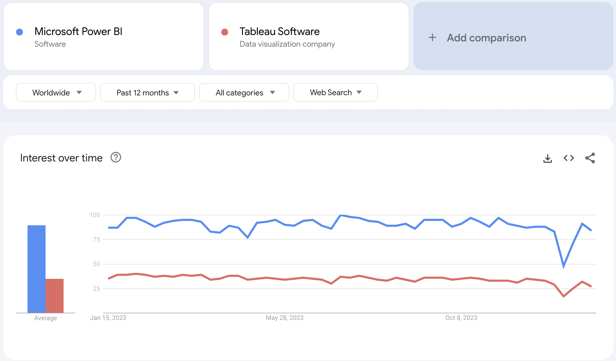
Google Trend..
For More insight check the link: https://trends.google.com/trends/explore?geo=GB&q=%2Fg%2F11clr_l6ft,%2Fm%2F02s9k80&hl=en-US
Notes:
As we explore the landscape of Business Intelligence tools, it's crucial to understand the global trends and interests surrounding our potential choices. Today, we delve into Google Trends to gain insights into the relative search interest over time for Power BI and Tableau."
Google Trends Analysis: "Now, let's take a closer look at the data." [Present the graph showing the trends]
Key Observations: "As we observe the trends over the past 12 months, a clear pattern emerges."
"Power BI consistently exhibits a higher level of search interest compared to Tableau."
"This sustained interest suggests a growing and continued curiosity and engagement with Power BI on a global scale."
Implications: "What does this mean for us?"
"The higher search interest in Power BI may indicate a broader user base, increased adoption, and a robust community presence."
Consideration for Decision-Making: "While Google Trends is just one piece of the puzzle, it aligns with the broader narrative of Power BI's popularity and adoption. This information could potentially influence our decision-making process regarding the selection of the BI tool for our organization."
Conclusion: "As we navigate this decision-making journey, it's essential to consider not only the features and capabilities but also the global trends and community support.

Slide 22
Conclusion and Recommendations
Choice depends on requirements and budget.
Power BI: User-friendly, affordable for small teams.
Tableau: Capable with large datasets, visually attractive, preferred by medium and large enterprises.
Recommendations based on business size.
Notes:
Conclusion and Recommendations
"As we conclude our comparison between Power BI and Tableau, it's evident that the right choice depends on specific requirements and budget considerations. Power BI emerges as a user-friendly and affordable solution, making it particularly well-suited for small teams and organizations. On the other hand, Tableau showcases its prowess in handling large datasets, presenting visually attractive dashboards, and being the preferred choice for medium and large enterprises. Considering our organizational size and needs, my verdict leans toward Power BI. Its agility, cost-effectiveness, and user-friendly features align seamlessly with the dynamics of our small organization. I invite any questions or further discussions on this critical decision-making aspect. Thank you for your attention."

Slide 23

Thank you

